Slide 1
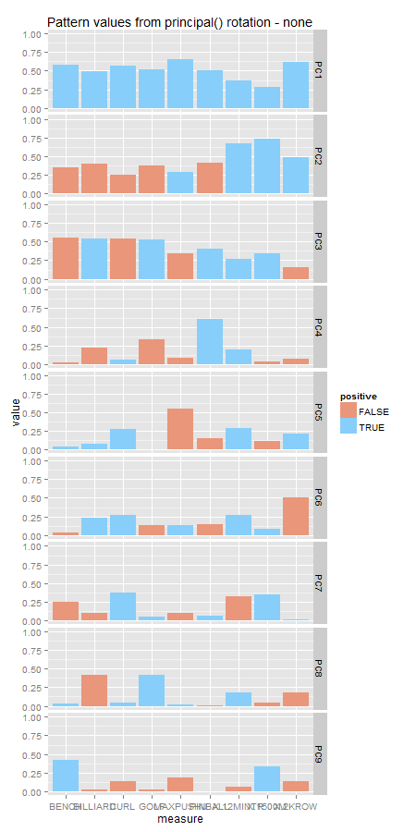
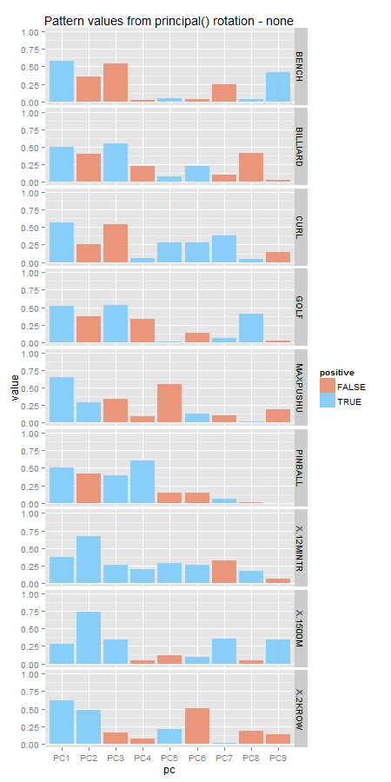
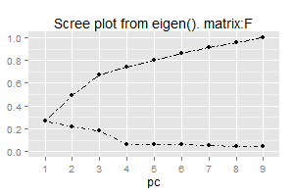
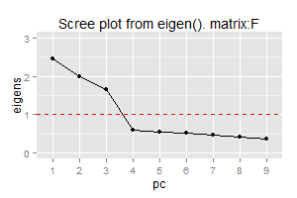
none
varimax
quatimax
promax
oblimin
simplimax
cluster
Notes:
none

Slide 2
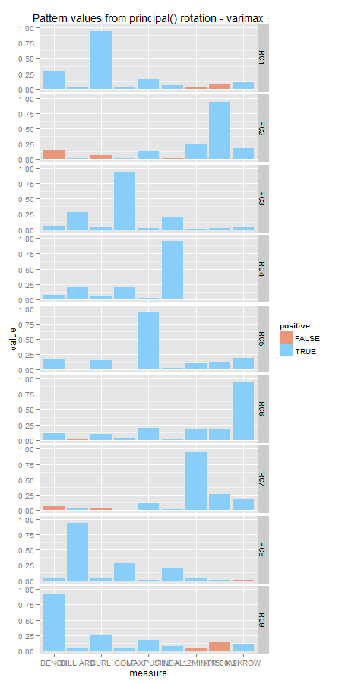
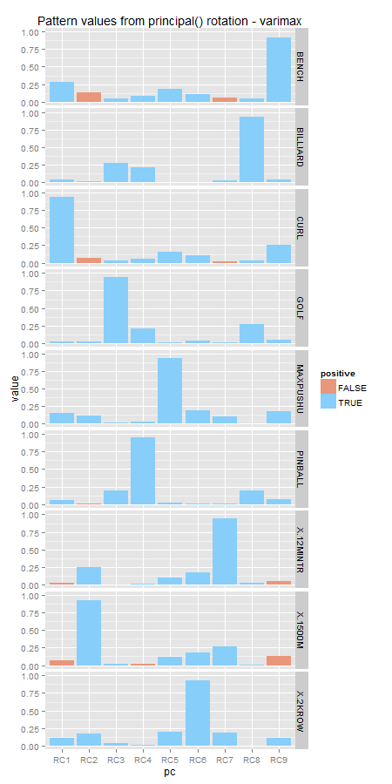
none
varimax
quatimax
promax
oblimin
simplimax
cluster
Notes:
varimax

Slide 3
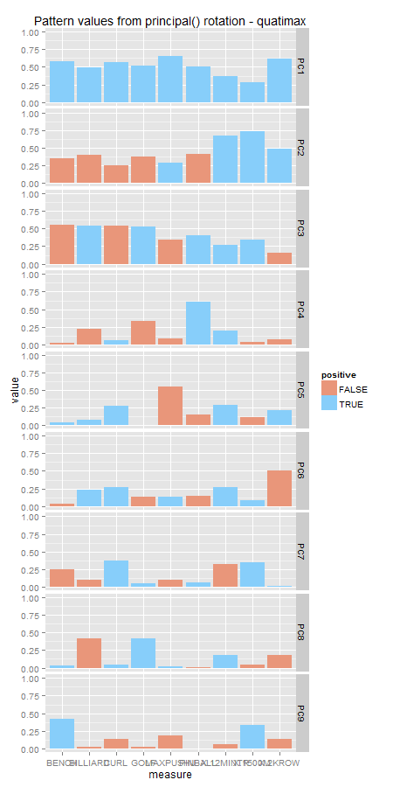
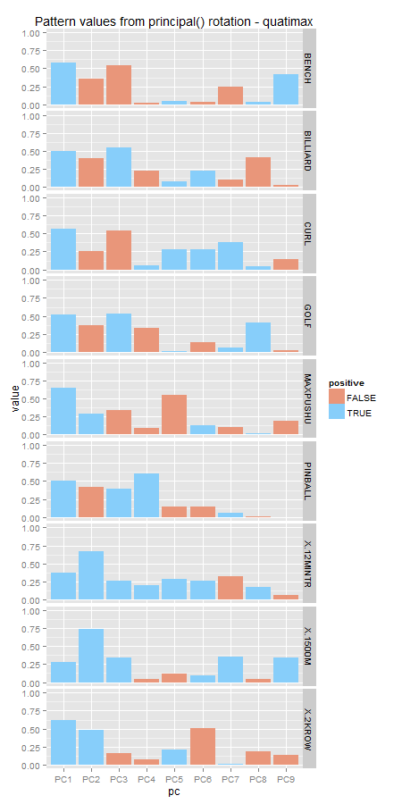
none
varimax
quatimax
promax
oblimin
simplimax
cluster
Notes:
quatimax

Slide 4
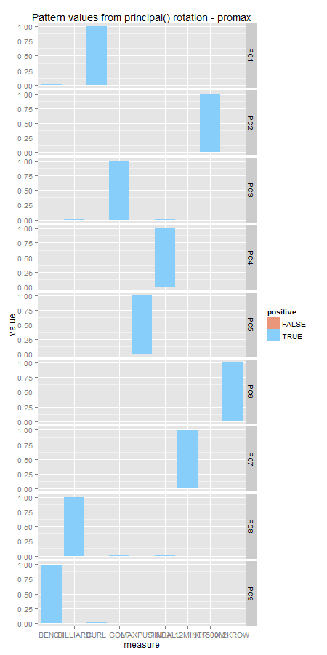
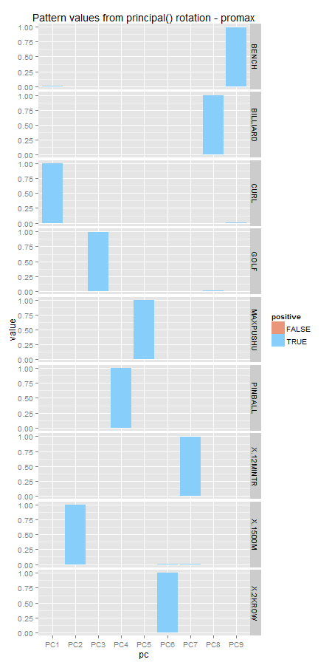
none
varimax
quatimax
promax
oblimin
simplimax
cluster
Notes:
promax

Slide 5
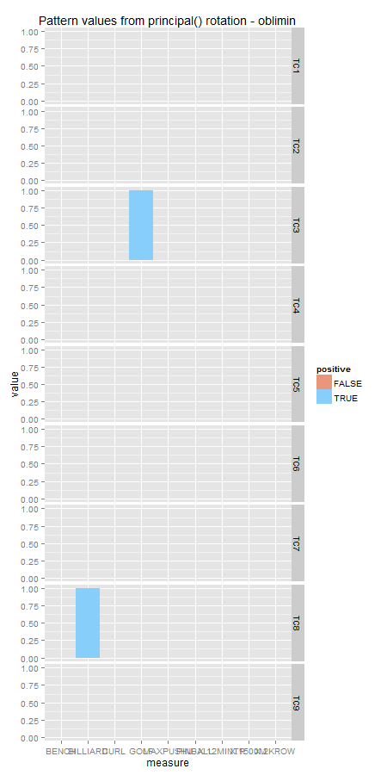
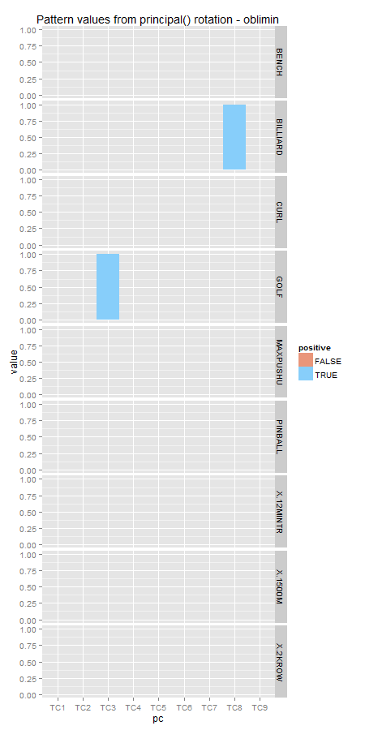
none
varimax
quatimax
promax
oblimin
simplimax
cluster
Notes:
oblimin

Slide 6
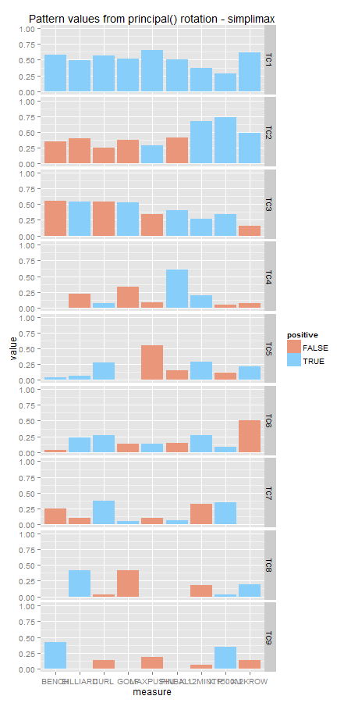
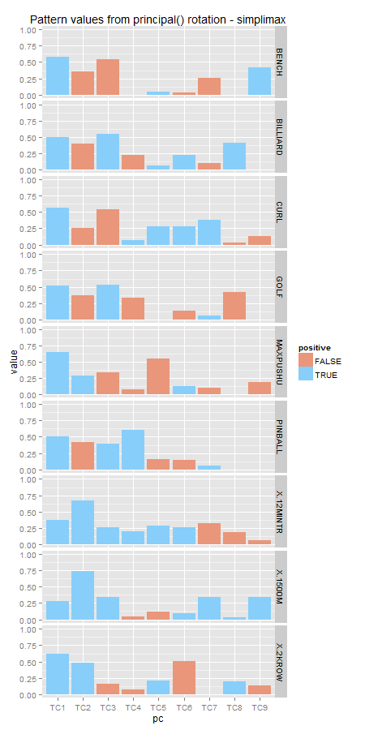
none
varimax
quatimax
promax
oblimin
simplimax
cluster
Notes:
simplimax

Slide 7
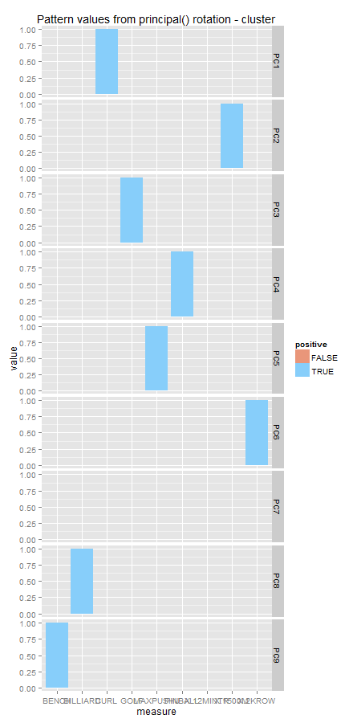
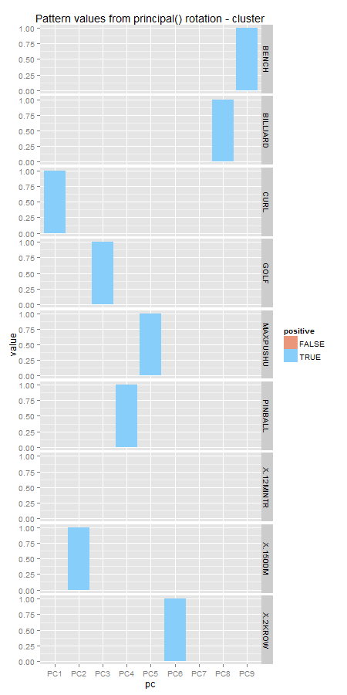
none
varimax
quatimax
promax
oblimin
simplimax
cluster
Notes:
cluster

